Slide 1
COMP 2100
Data Structures

Slide 2
Who am I?
Dr. Barry Wittman
Not Dr. Barry Whitman
Education:
PhD and MS in Computer Science, Purdue University
BS in Computer Science, Morehouse College
Hobbies:
Reading, writing
Enjoying ethnic cuisine
DJing
Lockpicking
Stand-up comedy

Slide 3
How can you reach me?
E-mail: wittman1@otterbein.edu
Office: C123 (Art & Communication Building)
Phone: (614) 823-2944
Office hours: MWF 9:00 – 10:15 a.m.
MWF 1:45 – 2:45 p.m. (in C142)
W 4:00 – 5:00 p.m.,
TR 10:00 – 11:30 a.m.,
TR 2:00 – 4:00 p.m.,
and by appointment
Website:
http://faculty.otterbein.edu/wittman1/

Slide 4
Who are you?
Notes:
FAA Game

Slide 5
Why are we here?
State your name, and give the salutation you would prefer: Mr., Ms., or another
What's the purpose of this class?
What do you want to get out of it?
Do you want to be here?

Slide 6
Course Overview

Slide 7
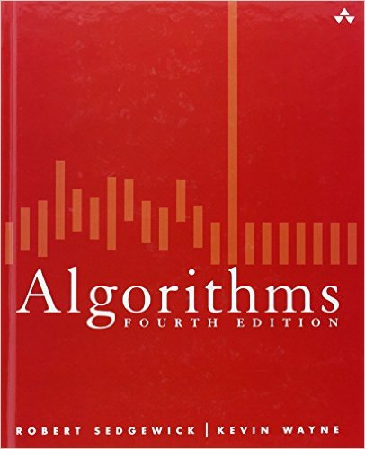
Textbook
Robert Sedgewick and Kevin Wayne
Algorithms
4th Edition, 2011, Addison-Wesley Professional
ISBN-10: 032157351X
ISBN-13: 978-0321573513

Slide 8
You have to read the book
You are expected to read the material before class
If you're not prepared, you may be asked to leave
You will forfeit the opportunity to take quizzes
Much more importantly, you will forfeit the education you have paid so much money to get

Slide 9
Course focuses
Java expertise
Computational complexity
Recursion
Sorting
Graph algorithms
Data structures
Stacks
Queues
Binary trees
Hash tables
Undirected graphs
Directed graphs
Priority queues

Slide 10
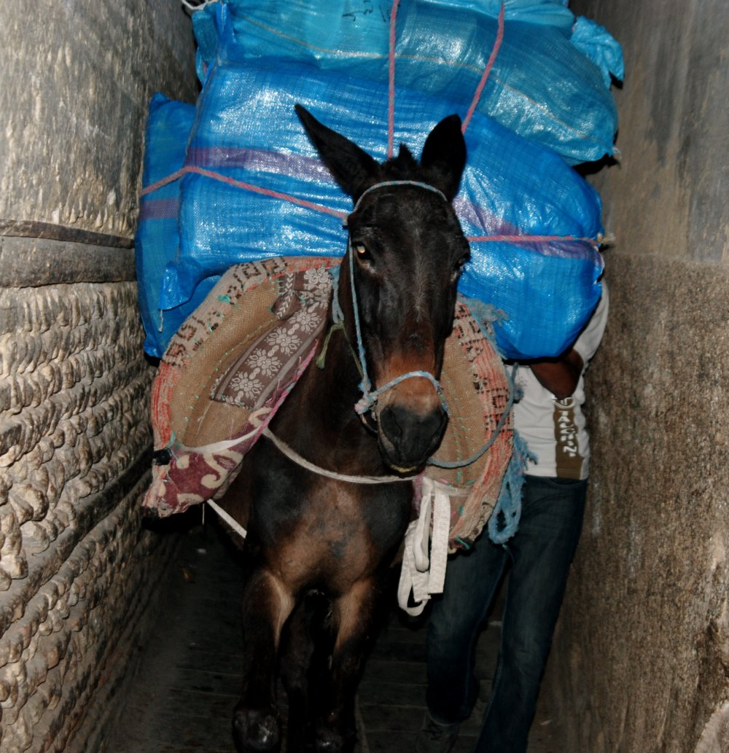
Ass load of content
This class is serious business
Big theoretical component
Big coding component

Slide 11
Imagine you're given a puzzle
If you can solve the puzzle, you're given a harder one
Once you start getting puzzles so hard you can't solve it, are you:
Discouraged and ready to give up?
Excited and eager for more?

Slide 12
Fixed vs. growth mindsets
People with fixed mindsets believe that they are unchanging
Either smart or stupid, good at CS or not
People with growth mindsets believe that they can change and improve
People who are excited by puzzles they can't solve have a growth mindset
Guess which mindset leads to greater happiness and success?

Slide 13
A note about help
This course is tough
Projects and assignments have a difficulty such that most students are expected to need help
Good students come to office hours for help
Good students ask questions in class if they don't understand things
Historically, the best students have asked the most questions
If you want to become a better student, ask more questions

Slide 14
A Taste of Data Structures

Slide 15
Linked lists
Singly linked
Doubly linked
Circular
Pros and cons?

Slide 16
Stacks and queues
Stacks
First-in-last-out data structure
Queues
First-in-first-out data structure

Slide 17
Trees
Binary search trees
Red-black trees
Tries
B-trees
C
B
E
A
D
F

Slide 18
Hash tables
Hash functions
Strategies for collisions

Slide 19
Sorting and searching
Linear search
Binary search
Heap sort
Quicksort
Merge sort
Counting sort
Radix sort

Slide 20
Graphs
Nodes and edges
Model for representing many problems
Traversals
Shortest paths
Spanning trees
Eulerian tours
Hamiltonian tours
NP-completeness
Network flow
B
A
D
C
E

Slide 21
More information
For more information, visit the webpage: http://faculty.otterbein.edu/wittman1/comp2100
The webpage will contain:
The most current schedule
Notes available for download
Reminders about projects and exams
Syllabus (you can request a printed copy if you like)
Detailed policies and guidelines

Slide 22
Projects

Slide 23
Four projects
36% of your grade will be four equally weighted projects
Each will focus on a different major area from the course:
Arrays and memory management
Stacks and queues
Trees
Graphs
You will work on each project in two-person teams

Slide 24
Teams
All projects are done in teams of two
You may pick your partners
But you have to have a different partner for each project!
Use Brightspace to form teams
Projects must be uploaded to Brightspace (https://otterbein.brightspace.com/)

Slide 25
Turning in projects
Projects must be uploaded to Brightspace before the deadline
Late projects will not be accepted
Exception: Each team will have 3 grace days
You can use these grace days together or separately as extensions for your projects
You must inform me before the deadline that you are going to use grace days
If two people in a team don't have the same number of grace days, the number of days they will have available will be the maximum of those remaining for either teammate

Slide 26
Assignments

Slide 27
Weekly assignments
14% of your grade will be from assignments, given roughly once every two weeks
4 of the assignments will be probably be written, and about 3 will be coding
There will be 7 assignments total
Assignments will not be due on weeks when projects are due
Each written assignment typeset in LaTeX is worth 1% extra credit applied to your final grade

Slide 28
Quizzes

Slide 29
Pop Quizzes
5% of your grade will be pop quizzes
These quizzes will be based on material covered in the previous one or two lectures
They will be graded leniently
They are useful for these reasons:
Informing me of your understanding
Feedback to you about your understanding
Easy points for you
Attendance

Slide 30
Exams

Slide 31
Exams
There will be two equally weighted in-class exams totaling 30% of your final grade
Exam 1: 09/23/2024
Exam 2: 11/11/2024
The final exam will be worth another 15% of your grade
Final: 10:15 a.m. – 12:15 p.m.
12/13/2024

Slide 32
Exam format
Conceptual portion
Short answer or matching questions
Programming portion
Short programming problems you will write code for

Slide 33
Course Schedule

Slide 34
Tentative schedule
Week | Starting | Topics | Chapters | Notes
1 | 08/26/24 | Java, OOP, and generics | Notes, 1.1
2 | 09/02/24 | Complexity | 1.4 , 1.2 | Labor Day
3 | 09/09/24 | Stacks and queues | 1.3
4 | 09/16/24 | Linked lists | 1.3 | Project 1 Due
5 | 09/23/24 | Recursion | Notes | Exam 1
6 | 09/30/24 | Binary trees | Notes, 3.1
7 | 10/07/24 | Balanced binary search trees | 3.2, 3.3 | Project 2 Due
8 | 10/14/24 | Hash tables | 3.4 | October Break
9 | 10/21/24 | Graph Basics | 4.1, 4.3
10 | 10/28/24 | Graph Algorithms | 4.4, 6.2
11 | 11/04/24 | B-trees and Network Flow | 6.4 | Project 3 Due
12 | 11/11/24 | Sorting | 2.1, 2.2, 2.3 | Exam 2
13 | 11/18/24 | Heaps | 2.4, 5.1, 5.2
14 | 11/25/24 | Strings | 5.3 | Thanksgiving
15 | 12/02/24 | Review | All | Project 4 Due

Slide 35
Project schedule
Project 1: 9%
Tentatively due 09/20/2024
Project 2: 9%
Tentatively due 10/11/2024
Project 3: 9%
Tentatively due 11/08/2024
Project 4: 9%
Tentatively due 12/06/2024

Slide 36
Policies

Slide 37
Grading breakdown
36%
Four projects
Equally weighted
14%
Homework assignments
5%
Quizzes
30%
Two equally weighted midterm exams
15%
Final exam

Slide 38
Grading scale
A | 93-100 | B- | 80-82 | D+ | 67-69
A- | 90-92 | C+ | 77-79 | D | 60-66
B+ | 87-89 | C | 73-76 | F | 60-62
B | 83-86 | C- | 70-72

Slide 39
Attendance
You are expected to attend class
You are expected to have read the material we are going to cover before class
Missed quizzes cannot be made up
Exams must be made up before the scheduled time, for excused absences

Slide 40
R-E-S-P-E-C-T
I hate having a slide like this
I ask for respect for your classmates and for me
You are smart enough to figure out what that means
A few specific points:
Silence communication devices
Don't use the computers in class unless specifically told to
No food or drink in the lab

Slide 41
Computer usage
We will be doing work on the computers together
However, students are always tempted to use the Internet, etc.
Research shows that it is nearly impossible to do two things at the same time (e.g. use Reddit and listen to a lecture)
For your own good, I will enforce this by taking 1% of your final grade every time I catch you using your computer for anything other than course exercises

Slide 42
Academic dishonesty
Don't cheat
First offense:
I will try to give you a zero for the assignment, then try to lower your final letter grade for the course by one full grade
Second offense:
I will try to fail you for the course and try to kick you out of Otterbein
Refer to the syllabus for the school's policy
Ask me if you have questions or concerns
You are not allowed to look at another student's code, except for group members in group projects (and after the project is turned in)
Don't use AI tools like ChatGPT to write any code you turn in
I will use tools that automatically test code for similarity

Slide 43
Disability Services
The University has a continuing commitment to providing access and reasonable accommodations for students with disabilities, including mental health diagnoses and chronic or temporary medical conditions. Students who may need accommodations or would like referrals to explore a potential diagnosis are urged to contact Disability Services (DS) as soon as possible. DS will facilitate accommodations and assist the instructor in minimizing barriers to provide an accessible educational experience. Please contact DS at DisabilityServices@otterbein.edu. More info can also be found here. Your instructor is happy to discuss accommodations privately with you as well.

Slide 44
Upcoming

Slide 45
Next time…
I will do a refresher on:
Java syntax
Types
Libraries
Strings
OOP
Interfaces
Exceptions
Read 1.1
Ignore stuff about the StdIn and StdOut libraries the book provides

Slide 46
Reminders
Read section 1.1
Brush up on Java

